Slide 1



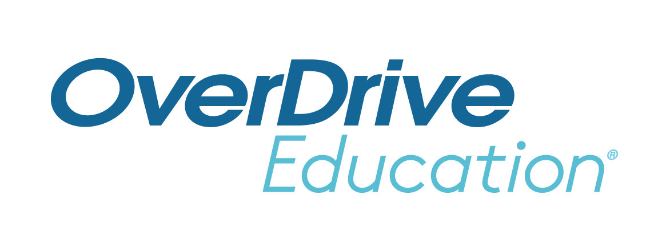
Add your school logo here!
Getting Started with Sora
© Copyright 2022, OverDrive, Inc.

Slide 2

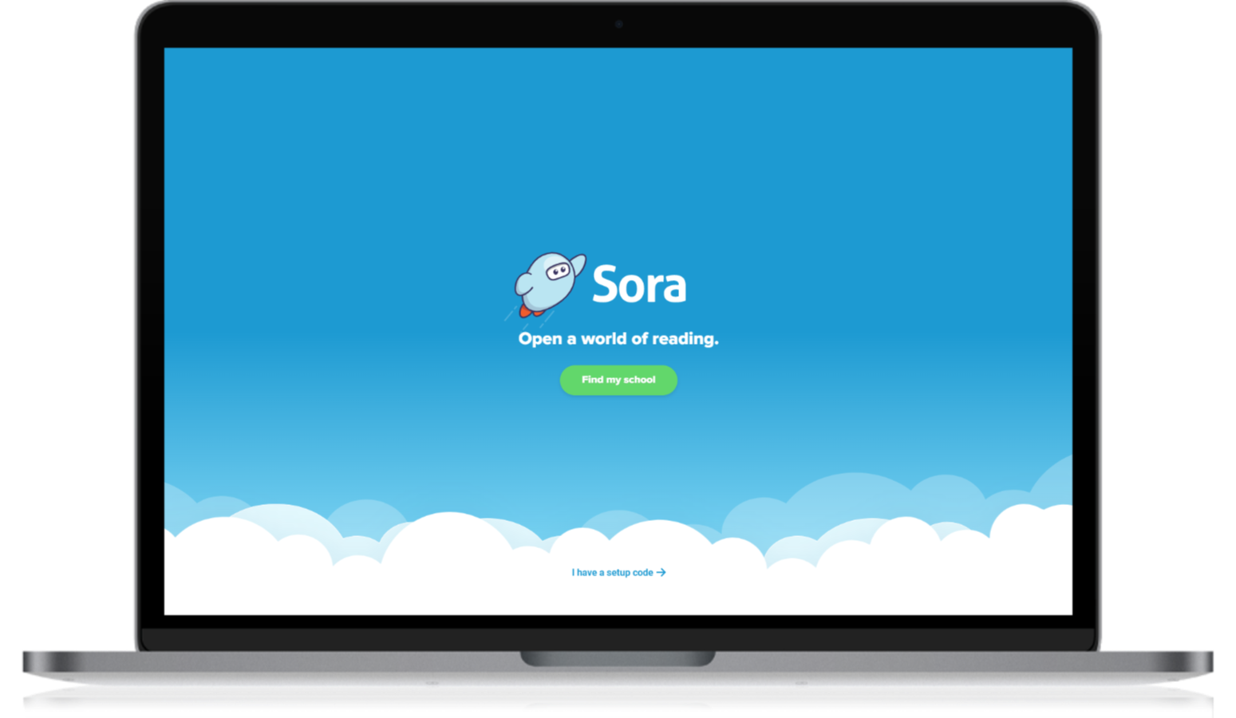
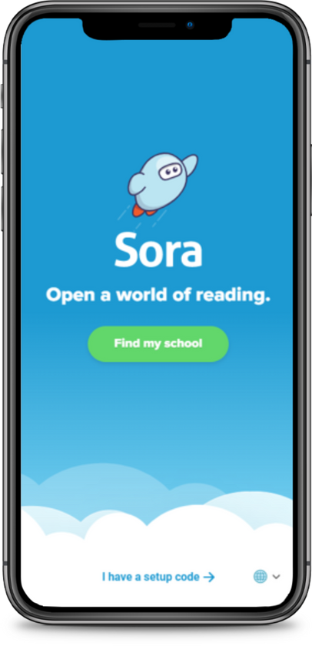

What is Sora?
Sora is the best way for students to access your school’s digital collection.
soraapp.com
or download the app
© Copyright 2022, OverDrive, Inc.
Notes:
2 ways to access – desktop or ap

Slide 3
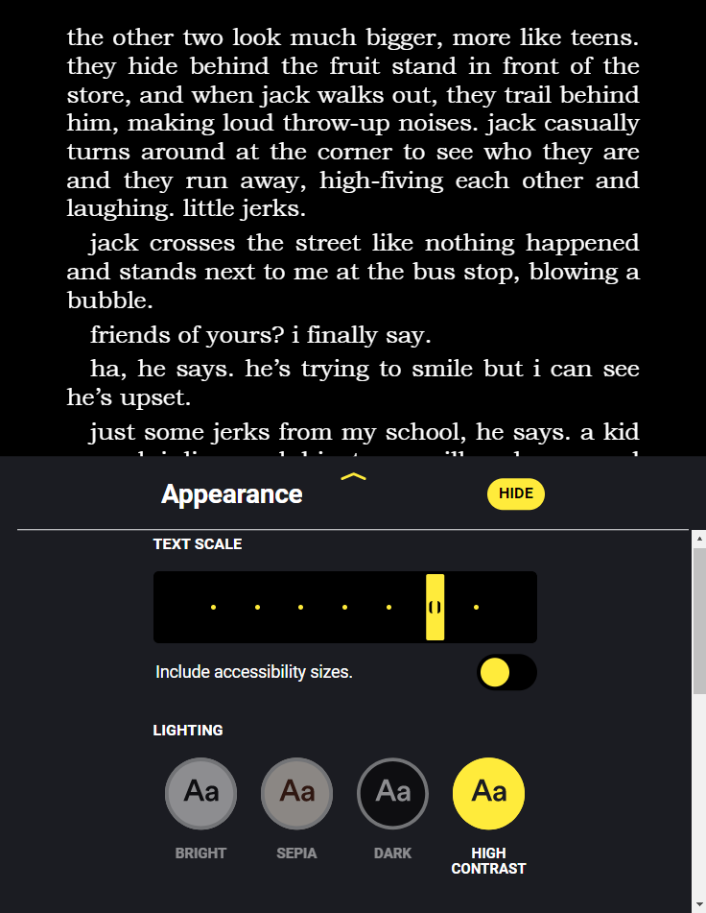
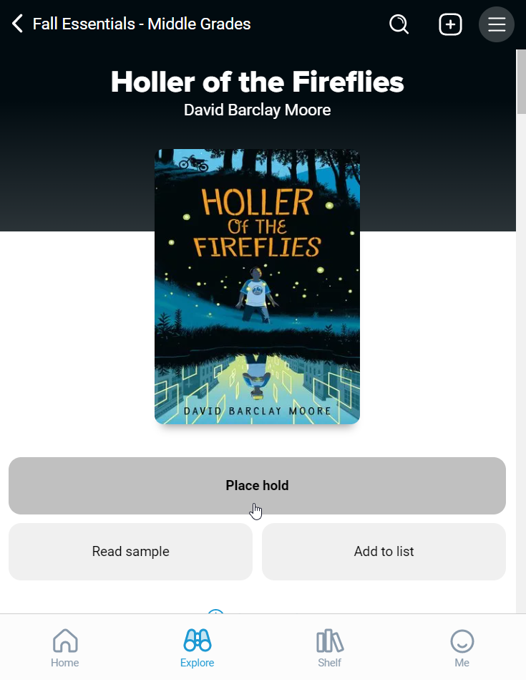
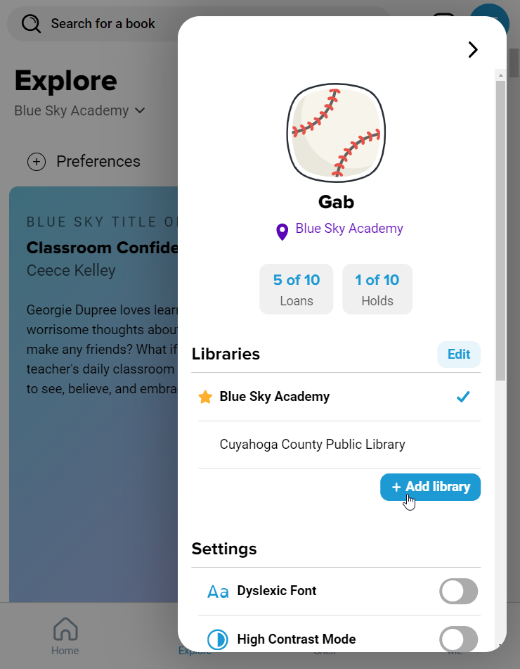
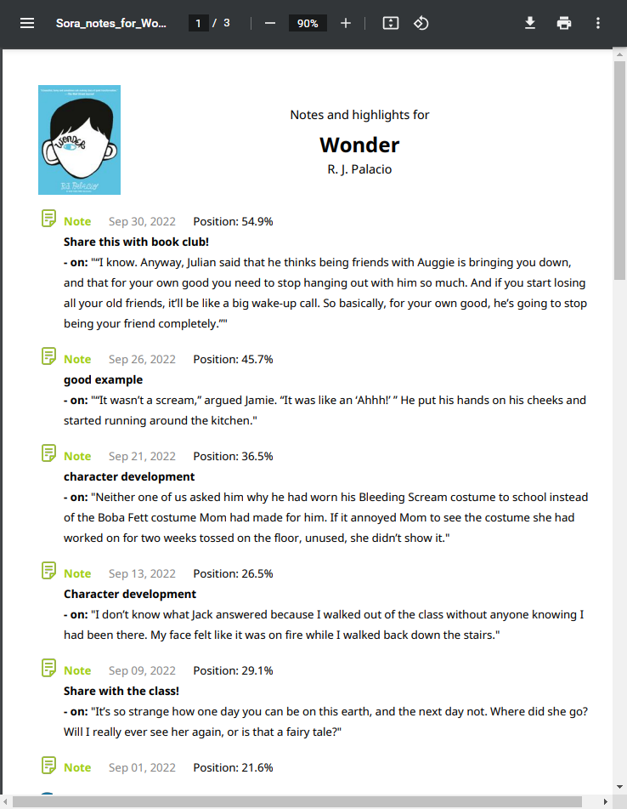
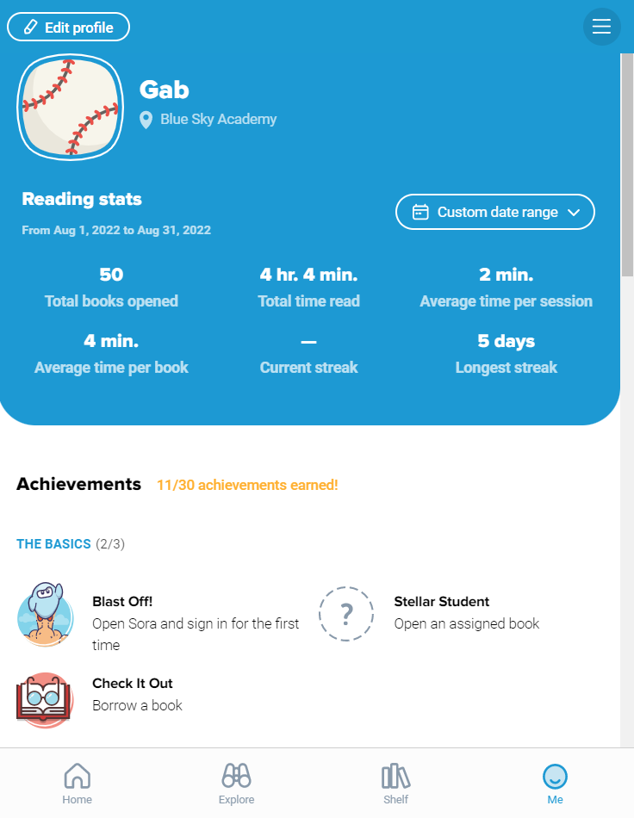
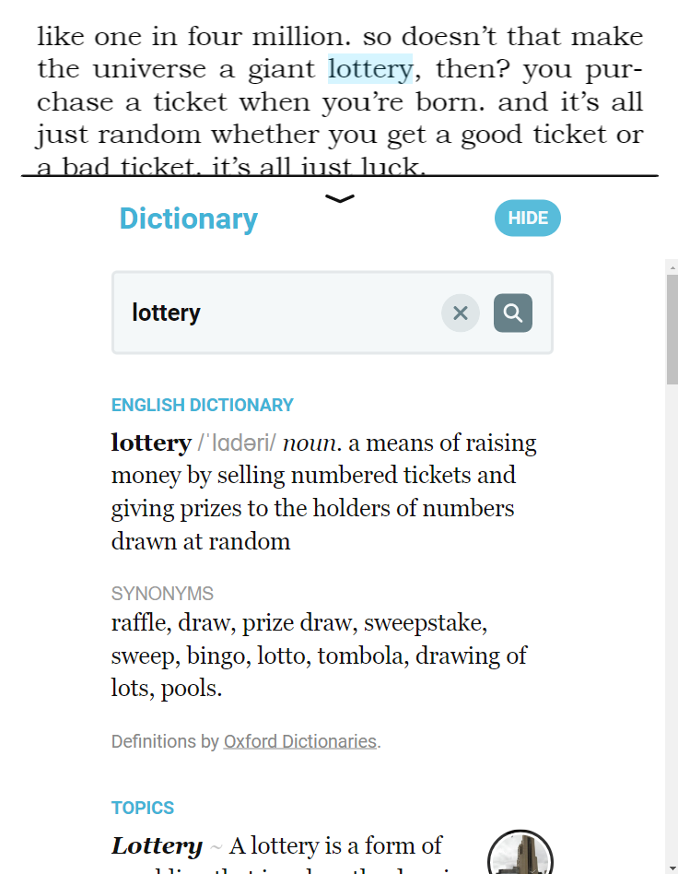
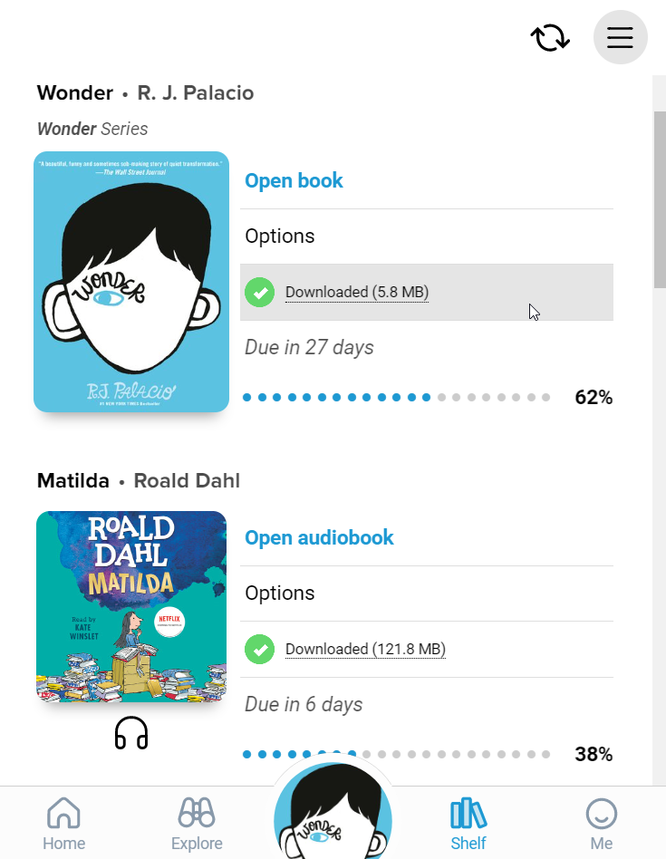
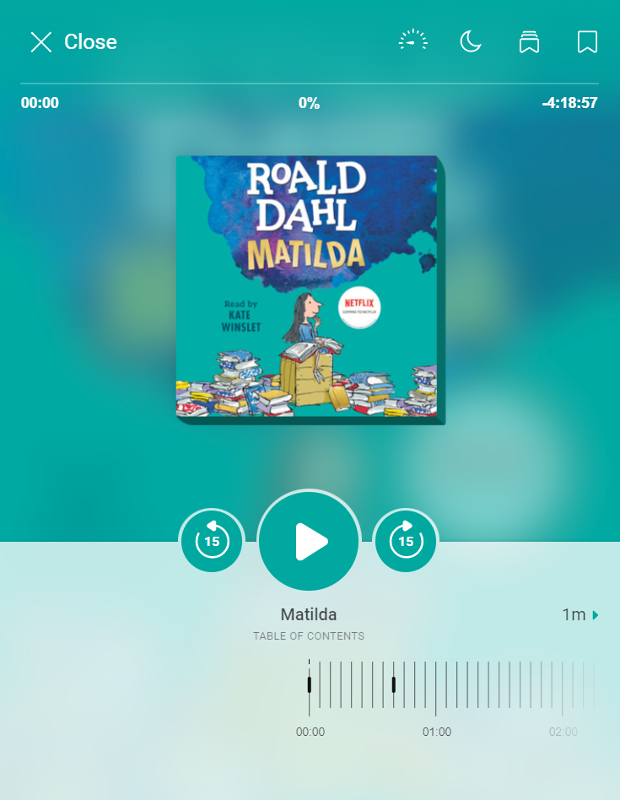
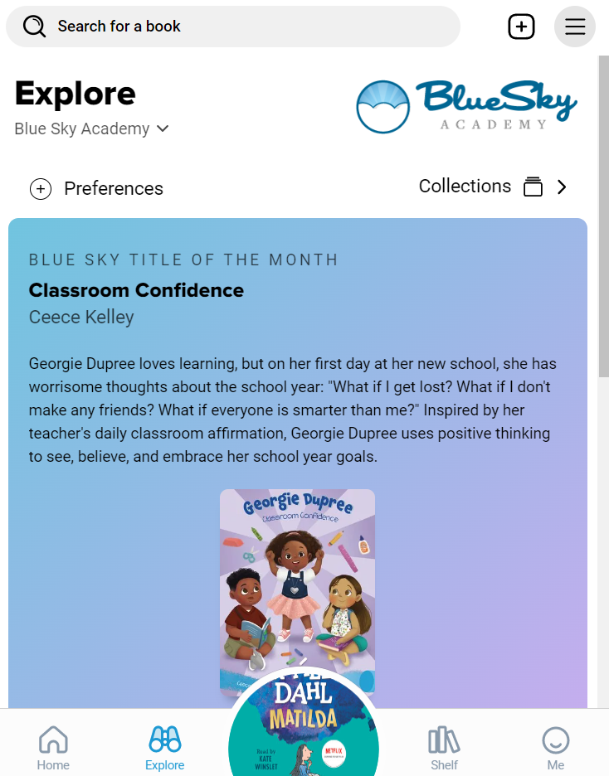
What can students do in Sora?
Read ebooks and listen to audiobooks.
Adjust reading or listening settings.
Read or listen offline.
Define new or unfamiliar words.
Add and export bookmarks, highlights, and notes.
Place books on hold.
View reading stats and earn achievements.
Add a public library for more books.
© Copyright 2022, OverDrive, Inc.
Notes:
Educators – each bullet point is animated to align with an image of the feature. Just click to advance!
All of these features are available for both students & staff in Sora.

Slide 4
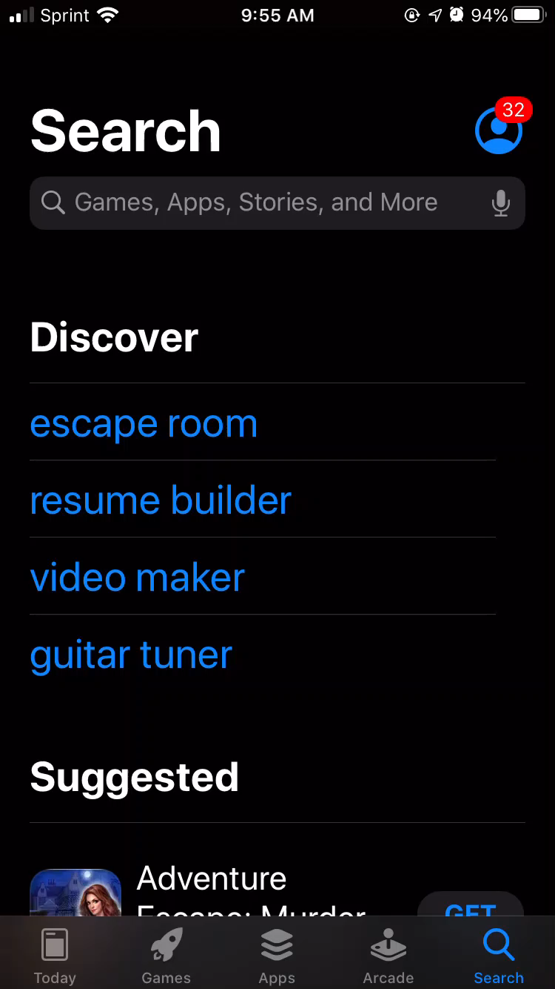
How do I get students started with Sora?
Direct them to download and open the app (on their personal device) or go to soraapp.com.
© Copyright 2022, OverDrive, Inc.
Notes:
Educators – In slideshow mode, the video of searching for the app will play automatically.
Staff will follow the same process to sign in.

Slide 5
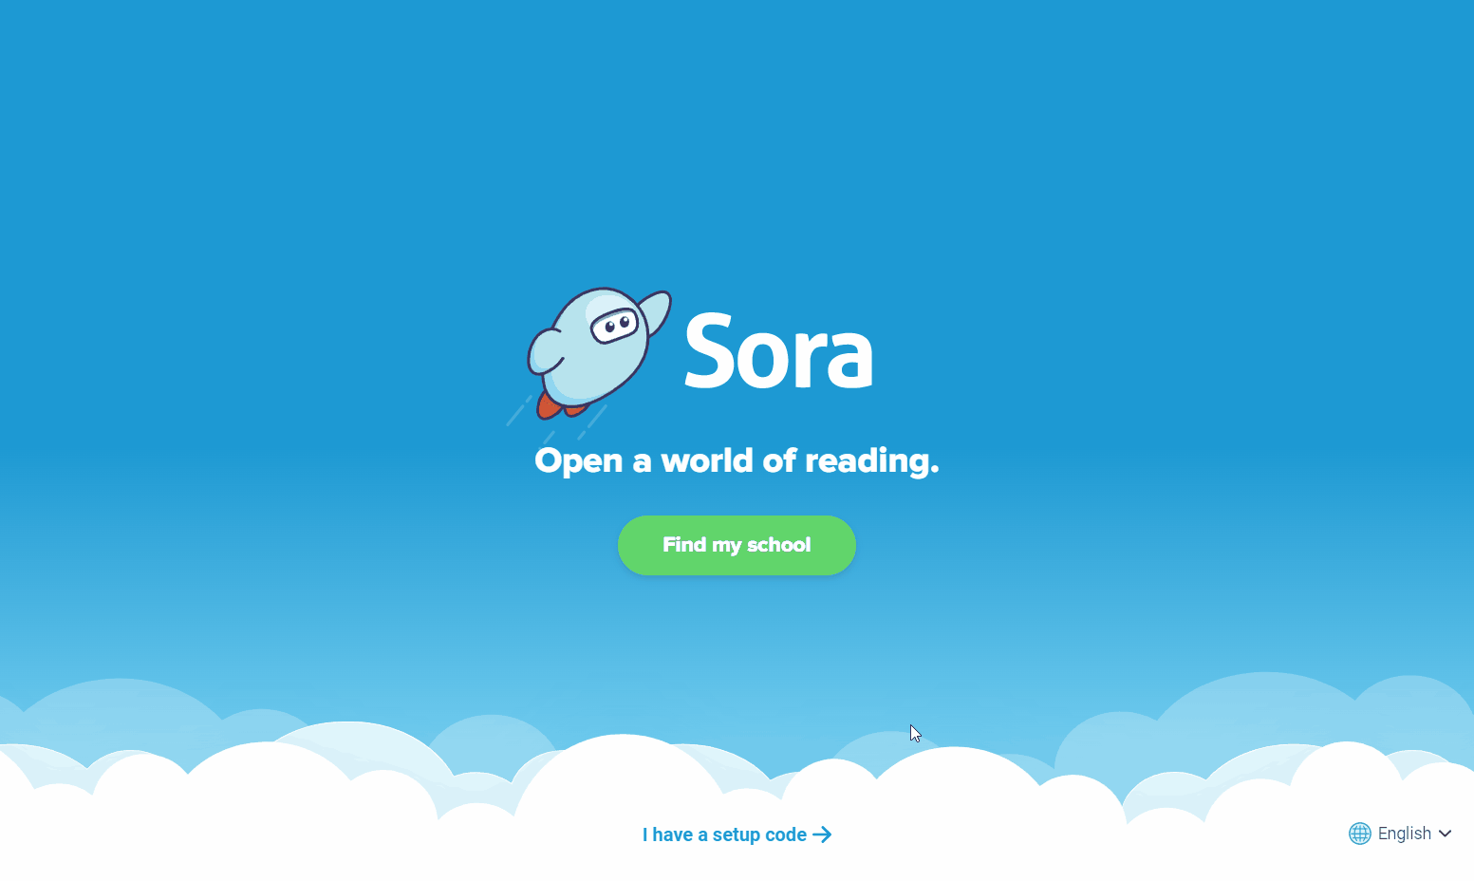
How do I get students started with Sora?
Direct them to download and open
the app (on their personal device)
or go to soraapp.com.
Search for your school (“Find my school”)
OR use your school’s setup code
(“I have a setup code”).
© Copyright 2022, OverDrive, Inc.
Notes:
Educators – The animation will play automatically.

Slide 6
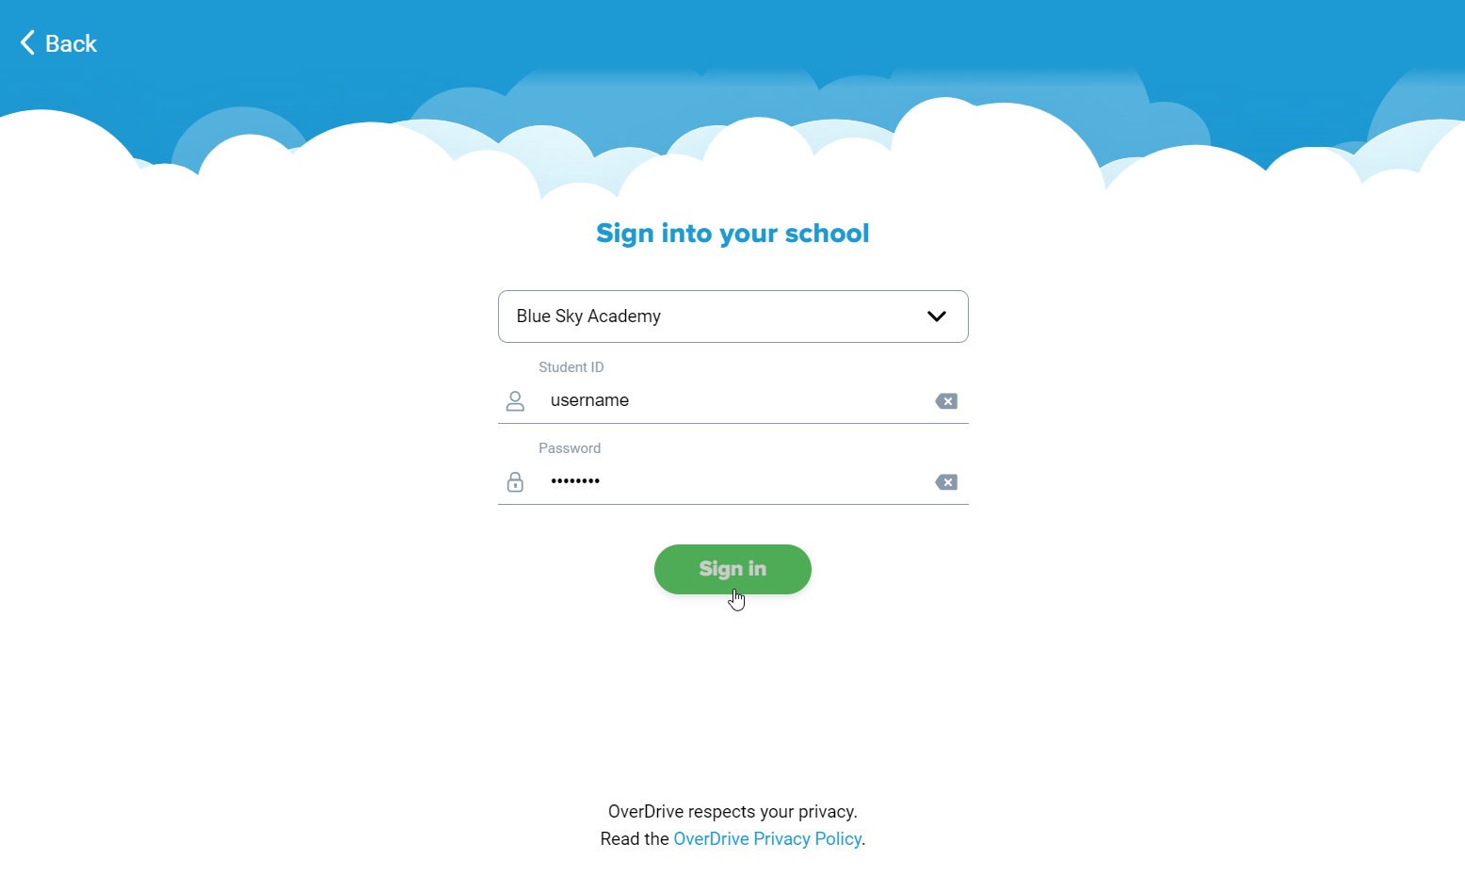
How do I get students started with Sora?
Direct them to download and open
the app (on their personal device)
or go to soraapp.com.
Search for your school or use
your school’s setup code.
Login with your school credentials.
© Copyright 2022, OverDrive, Inc.
Notes:
These will vary widely depending on what school they attend. Most schools will have students sign in with either an ID # or their school email address, depending on what Single Sign On method they use to access other school software.

Slide 7
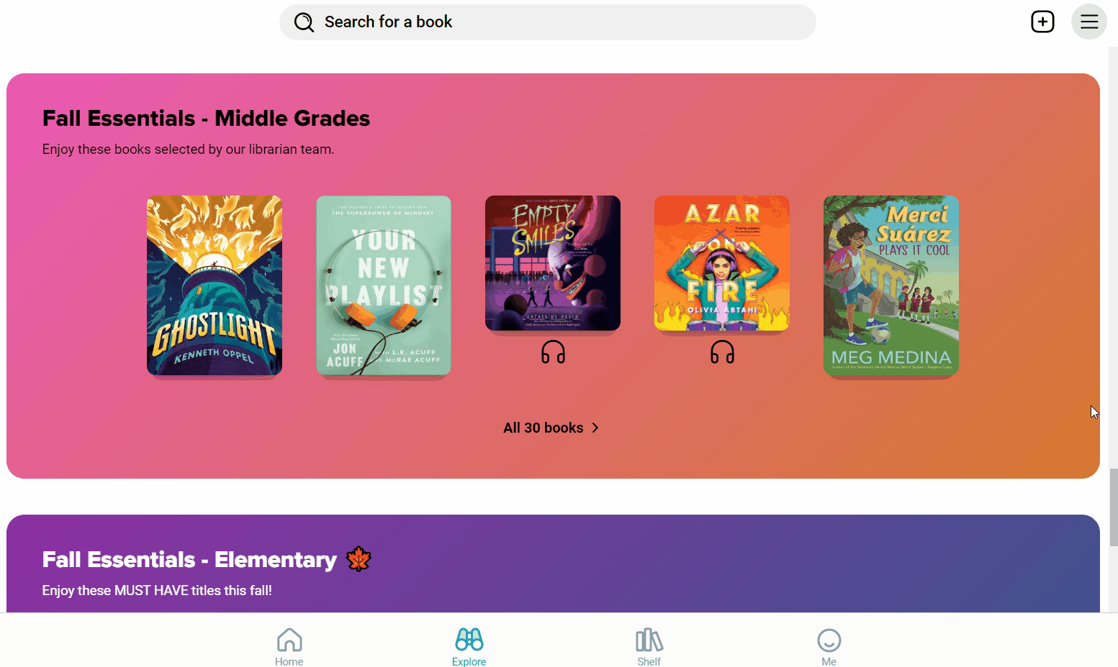
How do I get students started with Sora?
Direct them to download and open
the app (on their personal device)
or go to soraapp.com.
Search for your school or use
your school’s setup code.
Login with their school credentials.
Find a book, borrow, and read!
(Or listen!)
© Copyright 2022, OverDrive, Inc.
Notes:
Educators – The animation will play automatically.
Feel free to use this as an entry point for staff or as a recap – just drag and drop slides in any order you like (from the left-hand navigation pane).

Slide 8
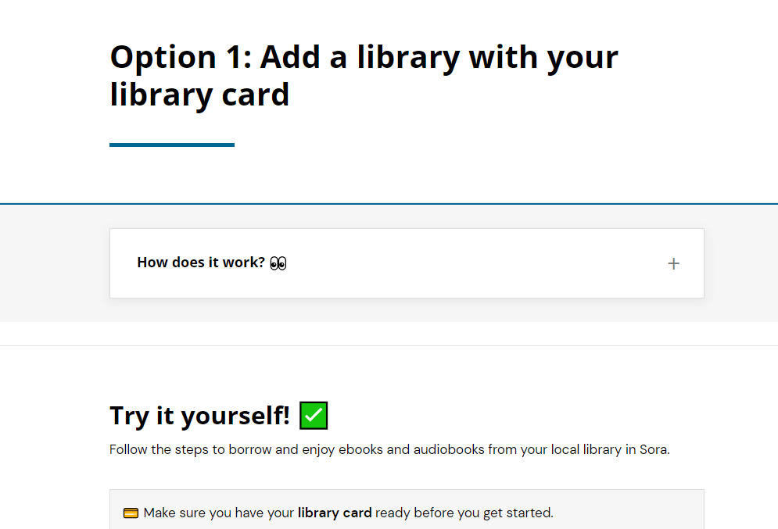
Animates how to add your public library using your library card information.

Slide 9
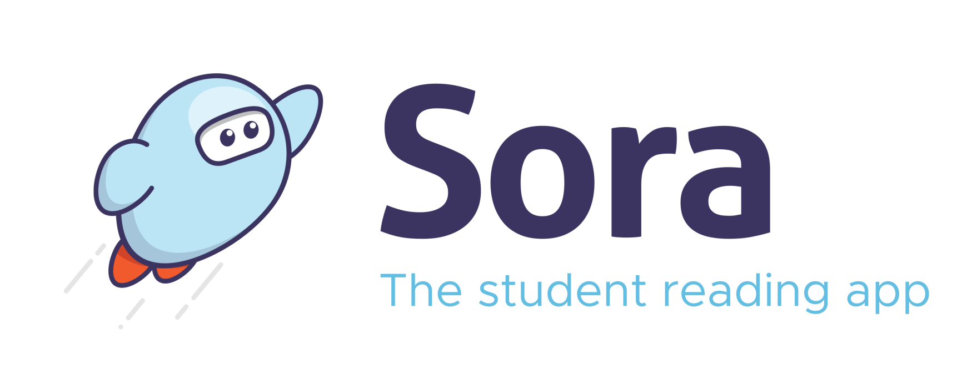











































Slide 10





















Notes:
For example, K-8 schools can indicate which students are in middle school and allow them to see the YA content.

Slide 11





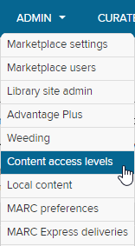































(Controlled by schools)

Slide 12








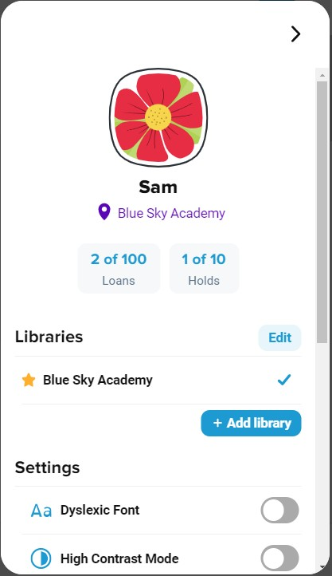















(Controlled by Sora)

Slide 13
Why use Sora instead of Libby?
Who’s in:
Some have access to some of the following:
IPS
Lawrence Township
Perry Township
Pike Township
Wayne Township
Decatur Central and Warren Central high schools
Other charter and private schools as well as Indiana School for the Deaf
School-owned collection
District-owned collection
Original shared collection created in Axis 360
New shared collection
About 5,000 more books that are NOT visible in Libby or in BiblioCommons

Slide 14
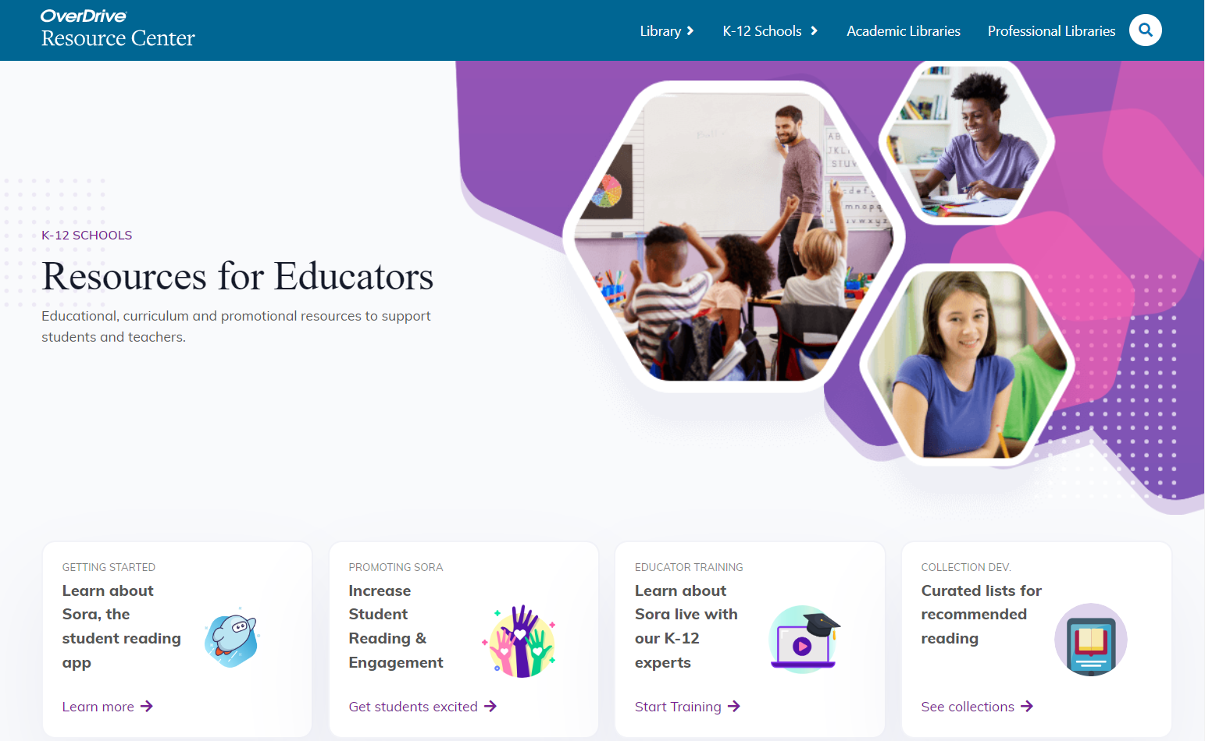
Resources
Learn more:
Meet Sora - https://www.overdrive.com/apps/sora.
Sora Help - help.soraapp.com.
Resource Center - resources.overdrive.com.
© Copyright 2022, OverDrive, Inc.

