Slide 1
Indianapolis Public Schools
TitleSource360
Jon Jezorski
Jon.Jezorski@baker-Taylor.com
1

Slide 2


Slide 3
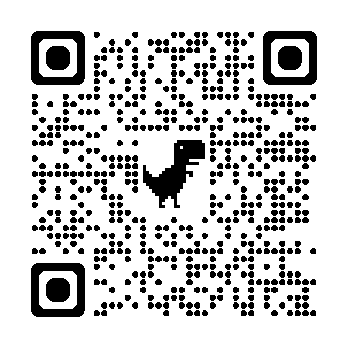
How to Log In
https://ts360.baker-taylor.com

Slide 4
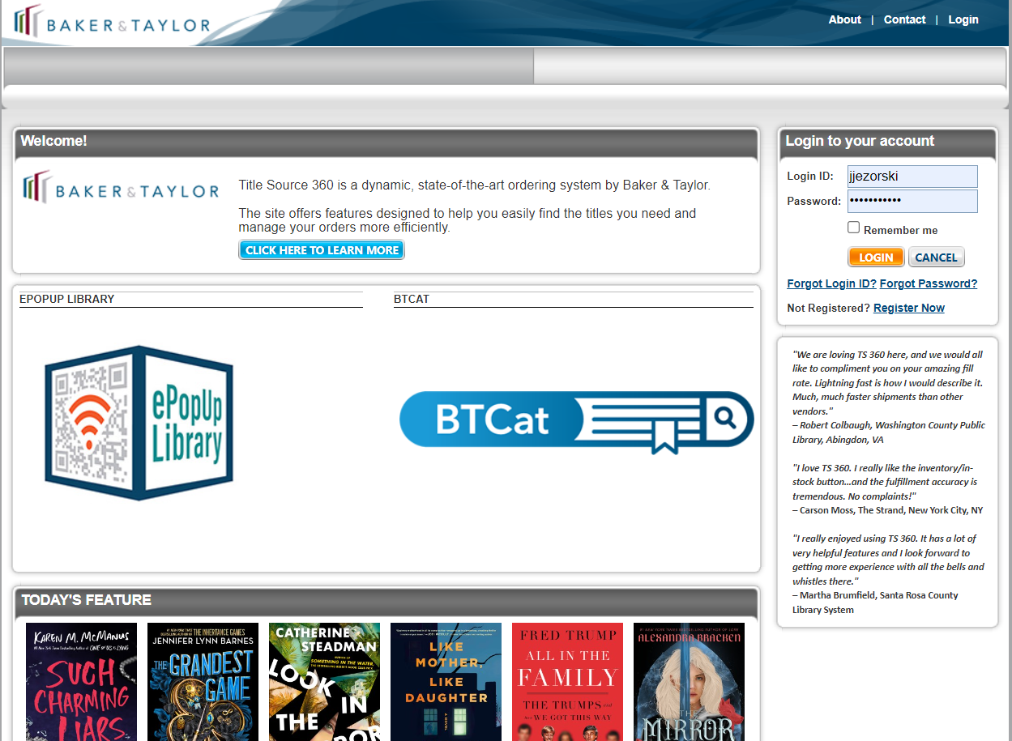

Slide 5
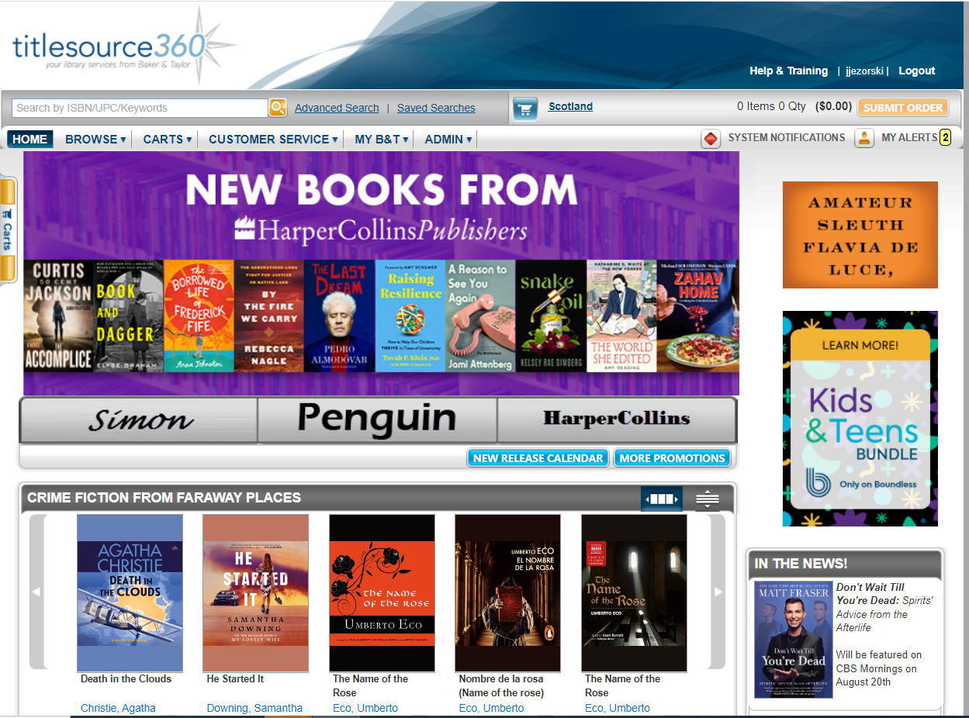

Hey There… I’m the Cart Drawer…You’re going to want to remember me!

Slide 6
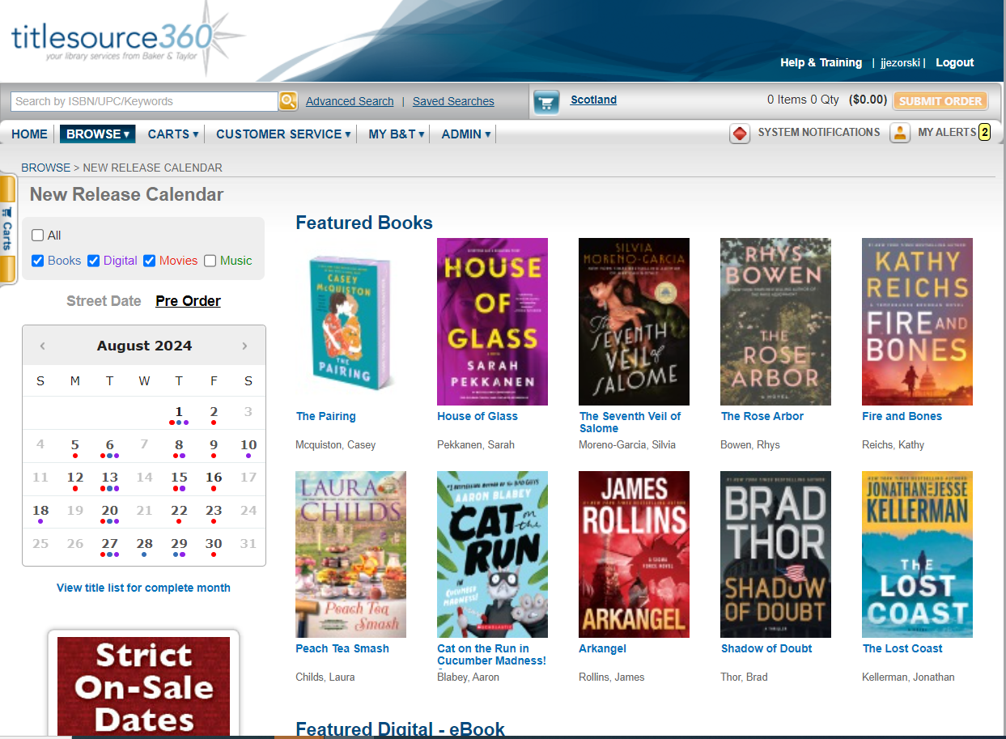
Hi Friend!

Slide 7
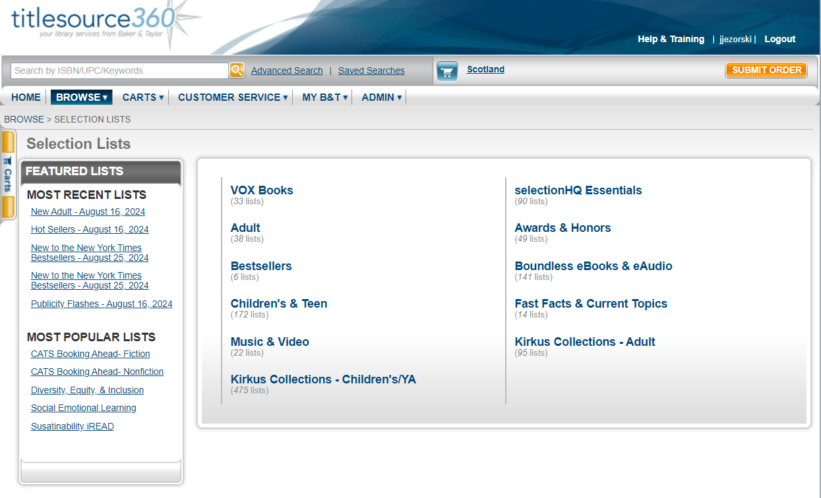
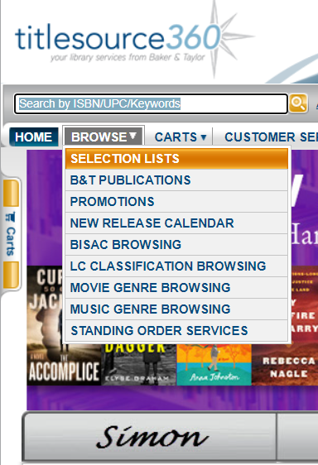

Slide 8
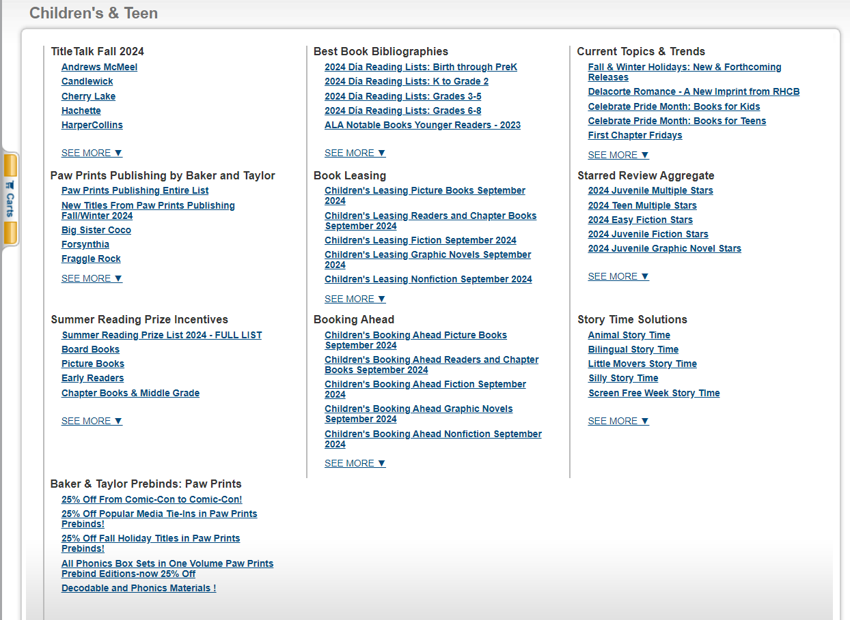
Psst…
I’m Still Here

Slide 9
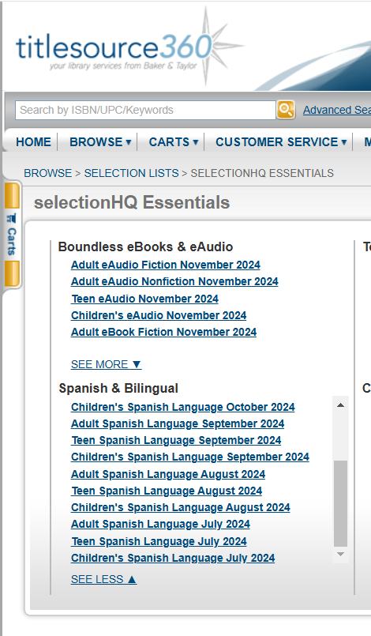
SPANISH COLLECTIONS

Slide 10




Slide 11

Remember this ISBN

Slide 12



Slide 13
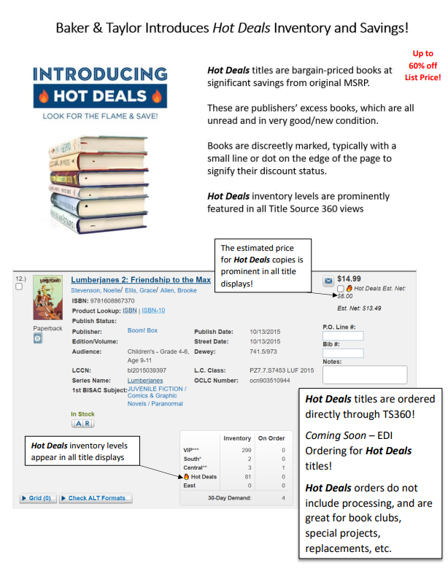

Hot Deals

Slide 14
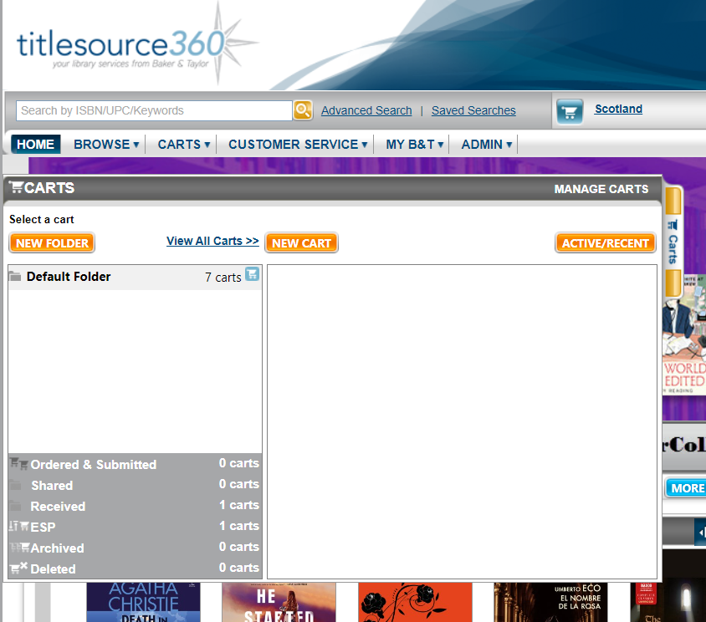
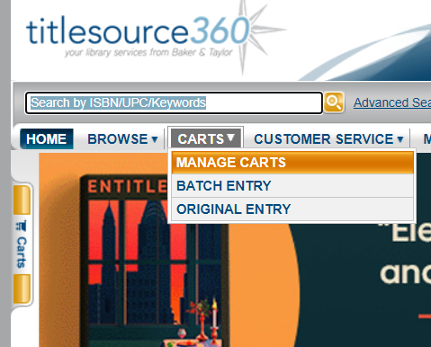
Ok… Here’s my Story

Slide 15
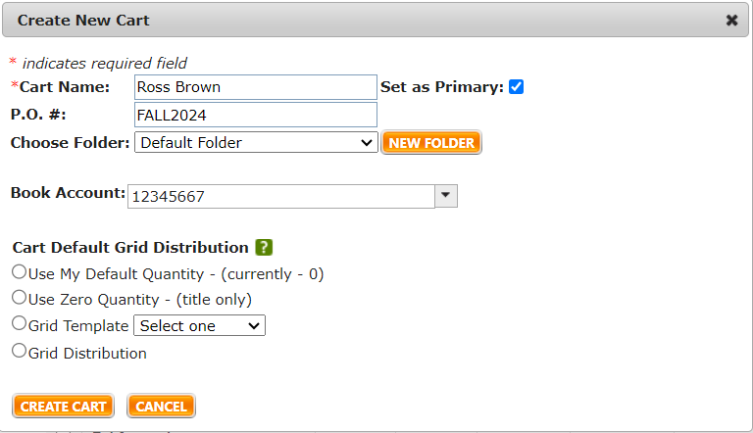

Slide 16
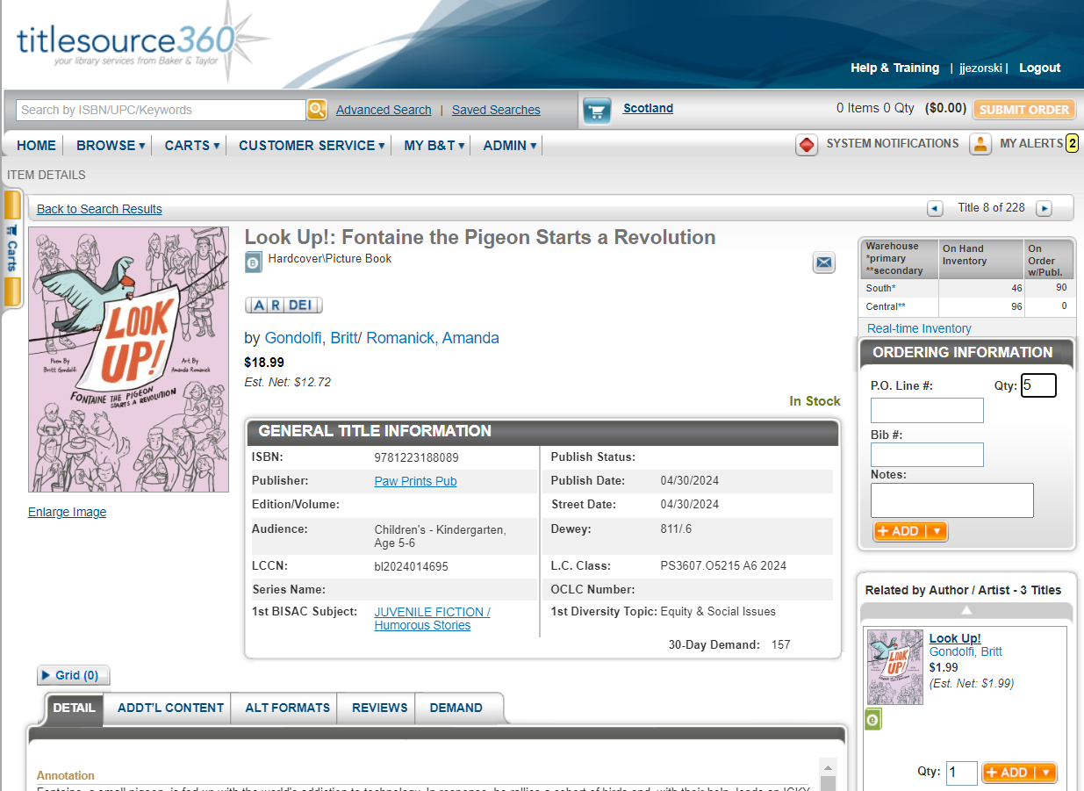

Slide 17
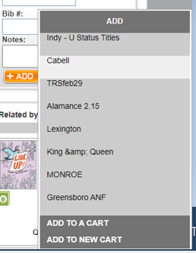

Slide 18
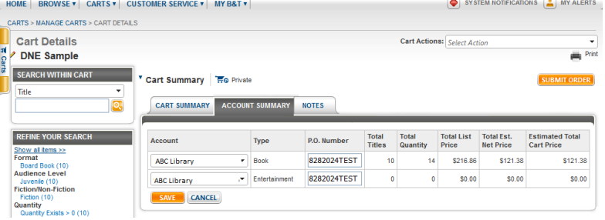
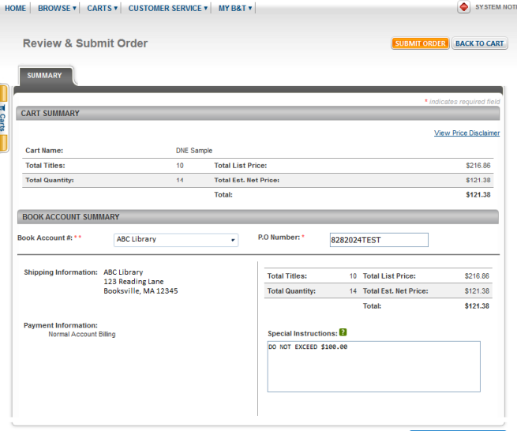
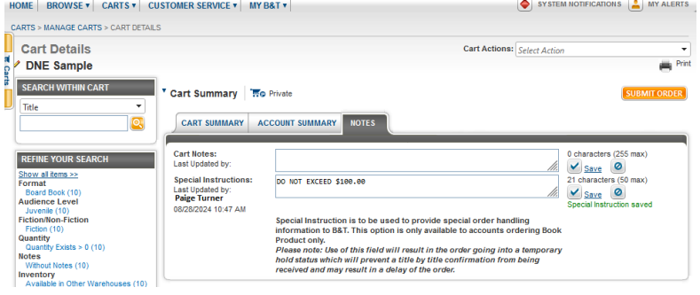
How to note your Do Not Exceed (DNE)
Notes:
When placing an order in Titlesource360, we suggest that you include titles that total 20% more than your maximum purchase allowed. If you are authorized to spend $100, please order books totaling $120 to allow for any items that may be unavailable and to ensure all funds are used. When all titles have been added to the cart, choose the Account Summary tab at the top of the cart. Verify the correct account has been selected and the P.O. Number field is complete. The PO# can contain a maximum of 13 characters, capital letters A-Z and numbers 0-9. No spaces or special characters are allowed. When complete, click the orange Save button

Slide 19
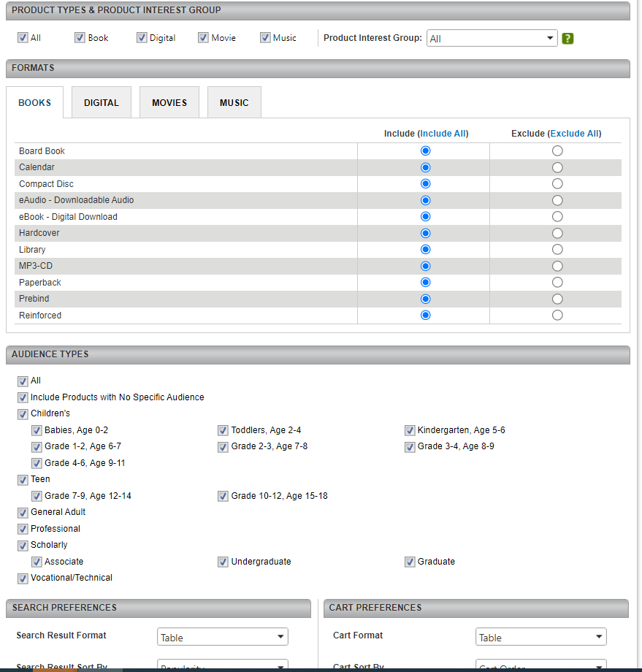
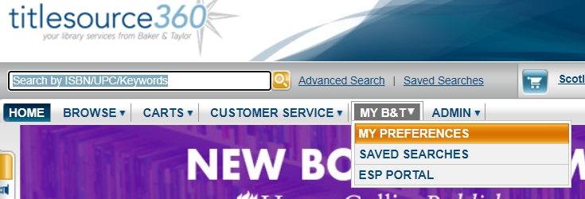

Slide 20
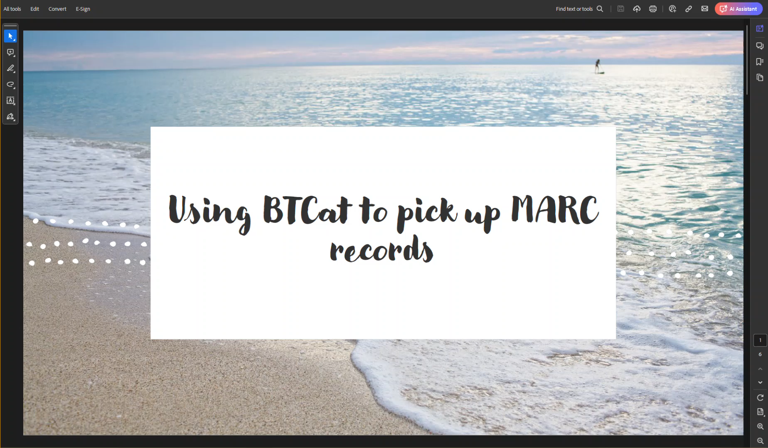

Slide 21
QUESTIONS?

